Slide 1
Equipment hours calculation Quang Thang Nguyen

Slide 2
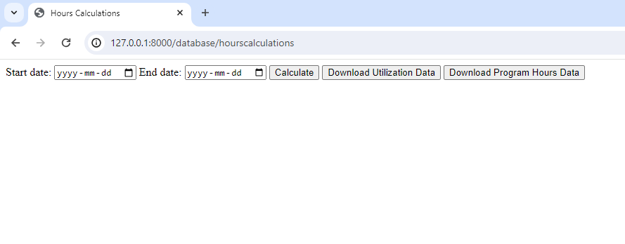
Website
User enters the period from which to calculate equipment/program hours.
Page will generate downloadable files to load into PowerBI.
One file will be equipment utilization hours, the other is the program hours.

Slide 3
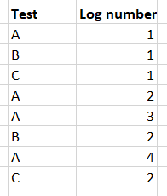
Log Order
Equipment hours will be calculated from logs.
Logs for all tests are put into one table.
This means logs are put one after another, in no particular order. Logs from different tests and chambers are mixed in this single line.
This is not important when distinguishing logs of different tests or chambers because we can filter them out.
But it is important to note when viewing logs for a single test with multiple circuits, because logs for circuits can be ordered differently each day.

Slide 4
Algorithm
The coded will go through each test in each chamber, in the specified time period; add up the hours for every program and chamber.
The rules on which this algorithm is developed are:
Logs indicate the status of the test (running, setup, waiting for product, stopped)
Only one test can run at a time inside of any chamber. If a log is submitted for another test in an occupied chamber (current test’s status is not stopped), it will not be recorded, and the user will be notified.
Statuses indicate the hours from that log up until the next log will all be recorded under that status (log is recorded at the start of the event).

Slide 5
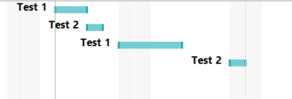
Algorithm
Assumptions:
Running hours that technicians enter are independent for each circuit (CCT1 may have 10 hours but CCT2 may have 5).
Status of circuits are independent of one another (CCT1 may run while CCT2 is stopped).
From these rules and assumptions, we can visualize the occupation of chambers by tests as follows.

Slide 6
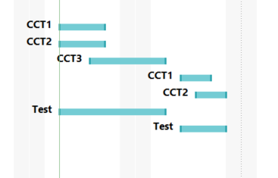
Algorithm
And the status of circuits in each test can be visualized as follows (pauses indicated that the circuit had been stopped).
Our code needs to recorded the first stretch of billable hours, and the second after the stopping of all circuits

Slide 7
Algorithm
1st possible solution: calculate the hours for each circuit – but circuits’s times may overlap each other, so this is not useful in calculating overall equipment and program hours.
2nd possible solution: Go through each day starting from the beginning of a test, if there’s a log that’s billable, add up the billable hours – this requires checking every day if a test has any logs, this takes a lot of computation time. And the independent total test hours assumption adds to complexity

Slide 8
Algorithm
One thing is certain: Because circuit statuses are independent of one another, the hours we calculate may be different depending on the order of circuit logs. However, total billable hours will remain the same.
One circuit may be running, another may be in set up, so which status’s hours do we record for the program and chamber? What about waiting for product? It’s possible that running and setup are mutually exclusive, but it’s possible for a circuit to be waiting for product as another’s running.
Another thing to consider is making these statuses mutually exclusive adds to the complexity of logging for technicians, as well as development time. As long as technicians make accurate logs (ensuring correct, mutually exclusive statuses across all circuits on their part), the hours should also be accurate.

Slide 9
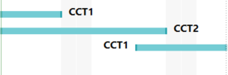

Algorithm
Solution:
Say we are tracking the log of a particular circuit. There are two cases when a circuit is stopped.
Case 1: There is another log with billable status on that date.
Case 2: There isn’t another log with billable status on that date.
We will keep track of the hours of a particular circuit as the hours of the program and chamber. Once we hit a “stopped” log or the last log (not the same as stopped) for that circuit, we search if there’s a billable log on that same date. If there is, we switch over to keep track of that circuit and keep updating the hours. If there isn’t, we skip to the next billable log and keep track of its circuit’s hours.
Example of case 1
Example of case 2

Slide 10
Algorithm
Solution:
How to do calculate the hours?
Running hours = (total test hour of current log – total test hour of previous log)
Hours of other statuses = [(timestamp of log – timestamp of previous log) rounded to the nearest day* maximum operable hours for the chamber] – (running hours)
When we switch to track another circuit:
Hours of any status = (timestamp of log – timestamp of previous circuit’s last log) rounded to the nearest day* maximum operable hours for the chamber
Example of case 1
Example of case 2

Slide 11
Algorithm
Note:
The calculation depends on the total test running time of each log, hours that are still rolling after a log won’t be recorded until the next log is put in.
This means that if a log is not recorded at the end of the calculation period for a test whose previous log is ‘running’ (for example), all the status hours from the previous log up until the end of the calculation period is not accounted for. However, this will be picked up if the next log is put in and another calculation which includes this log is ran.
If we want to avoid this, we can assume that as long as there’s no status change, the equipment time from the last log all goes towards the last status. This introduces some error, is not recommended.
Example of case 1
Example of case 2

Slide 12
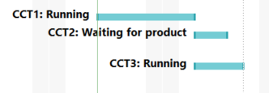
Algorithm
Potential error:
If the circuits' statuses are independent of each other, the detailed status hours may not be correct. This error would come when we have to switch the tracking of chambers. However, billable and non-billable hours would still be correct as billable and non-billable statuses are mutually exclusive.
For example, if one circuit is on “waiting for product”, and another is “running”. And we switch to the “waiting for product”, although we will still count the billable hours covered by the “running” circuit, we would classify it as “waiting for product”.

Slide 13
To clarify
1. Are statuses mutually exclusive?
Running vs. set-up (no)
Running, set-up, vs. waiting for product (no)
This avoids the error mentioned. But we can instead prioritize which circuit to switch tracking to depending on its status.
2. Do we assume that status hours from the last log up to the end calculation date are continuous? (not recommended)

